Slide 1
Antibiotic Resistance
“Potentially the cause of the next pandemic” - Professors Graham and Collignon
https://theconversation.com/scientists-around-the-world-are-already-fighting-the-next-pandemic-115246
Olivia Wilson, Dylan Terrell, and Gabrielle Hartman

Slide 2
Antibiotic resistance happens when germs like bacteria and fungi develop the ability to defeat the drugs designed to kill them. That means the germs are not killed and continue to grow.
CDC “About Antibiotic Resistance” https://www.cdc.gov/drugresistance/about.html

Slide 3
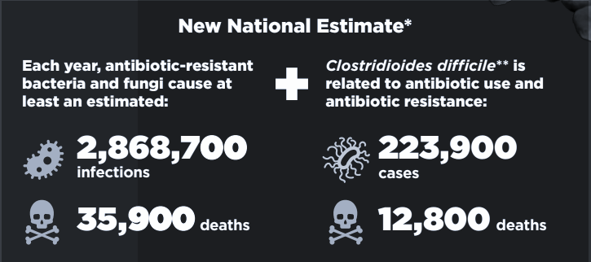
https://www.cdc.gov/drugresistance/pdf/threats-report/2019-ar-threats-report-508.pdf

Slide 4
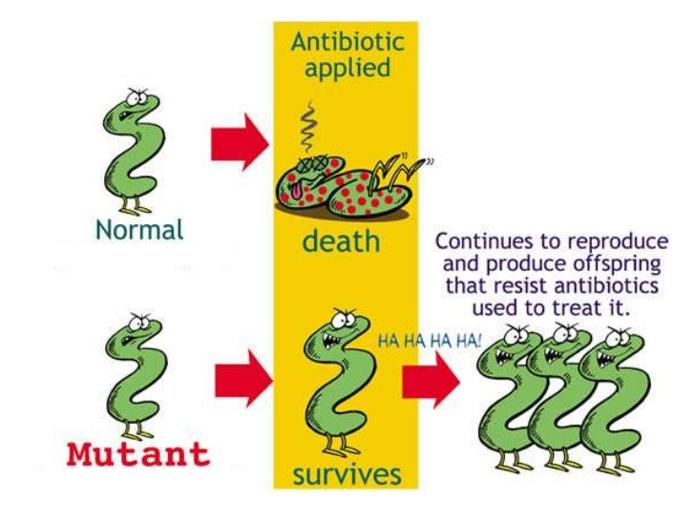

Slide 5
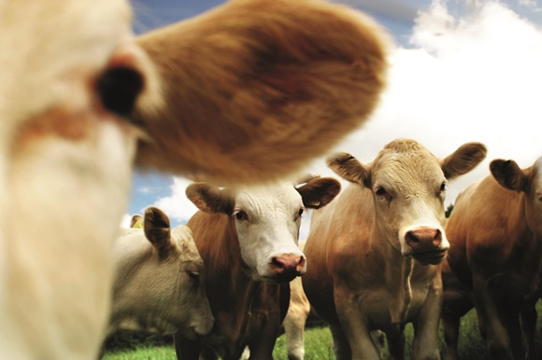

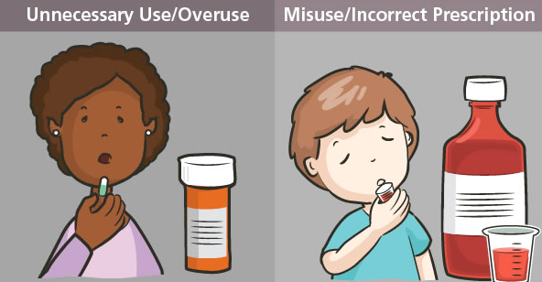

Drug availability
Environmental
Antibiotic Resistance
Unnecessary prescribing
Misuse

Slide 6
Our Focus
Bacteria and pathogens
Salmonella
E. Coli
S. Pneumoniae
S. Aureus
N. Gonorrhoeae
Acinetobacter
Antibiotics
Penicillins
Fluoroquinolones
Macrolides
Cephalosporins
Carbapenems
Notes:
6 pathogens that show increasing amounts of resistance to antibiotics
5 major drug classes

Slide 7
Data Collection
Data collected from
CDC
WHO’s Global Antimicrobial Resistance Surveillance System (GLASS)

Slide 8
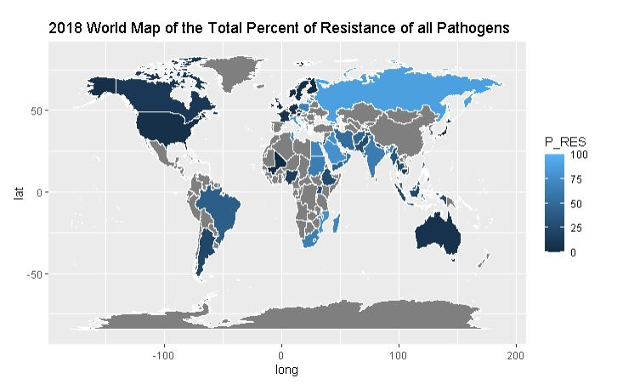

Slide 9
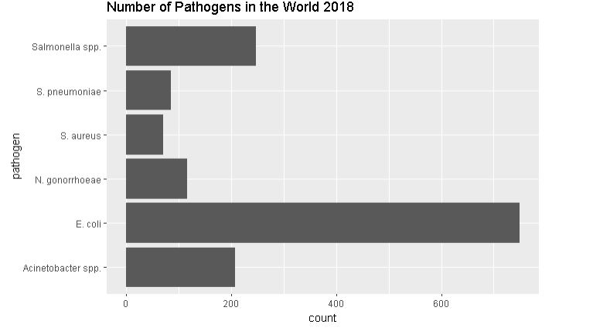
Notes:
Case counts in the world for these 6 pathogens in 2018

Slide 10
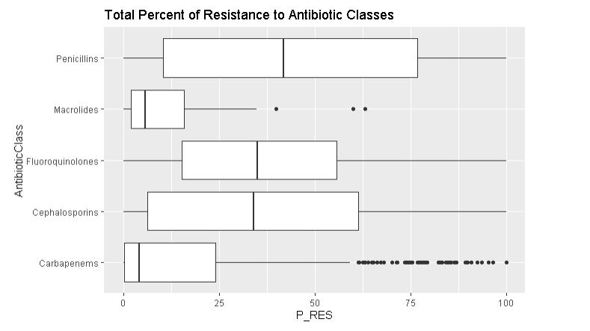
Notes:
All pathogens

Slide 11
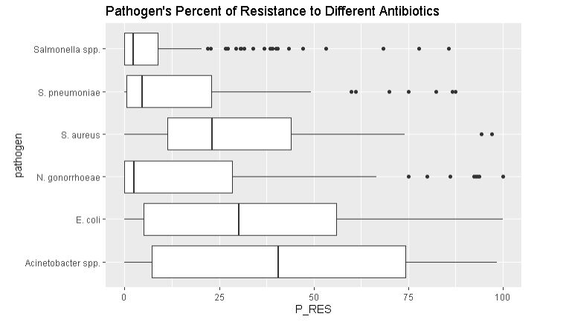
Notes:
All antibiotics

Slide 12
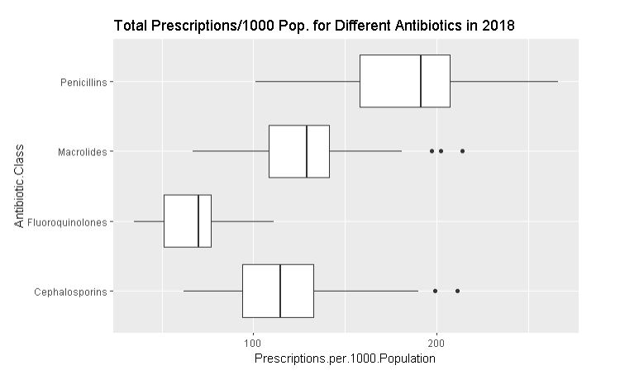
Notes:
Popularity with penicillins across the country

Slide 13
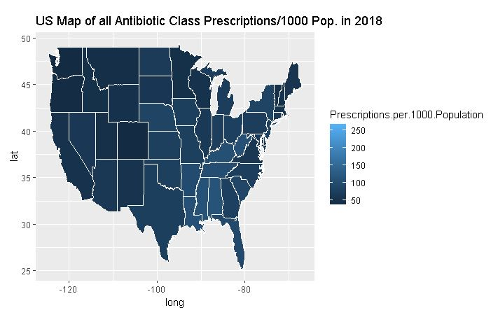

Slide 14
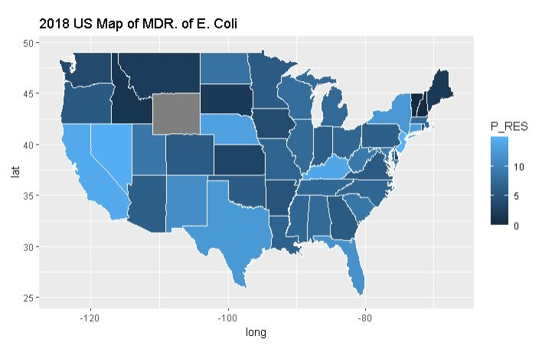
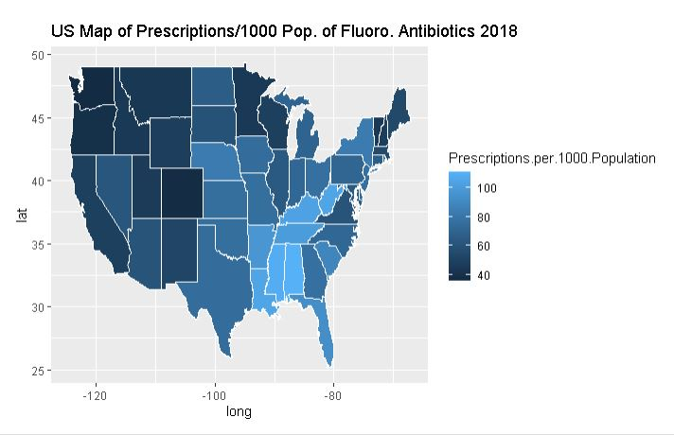

Slide 15
Conclusion
Antibiotic Resistance can affect anyone
Antibiotic resistant infections are much harder to treat
Antibiotic resistance should be taken seriously

Slide 16
What can we do?
Implementing strategies to decrease spread of infections within health care settings
Vaccinating
Keeping new threats from spreading
Proper education on prescribing and using antibiotics
Notes:
CDC’s guidelines

Slide 17
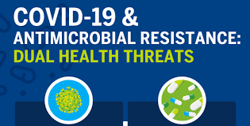
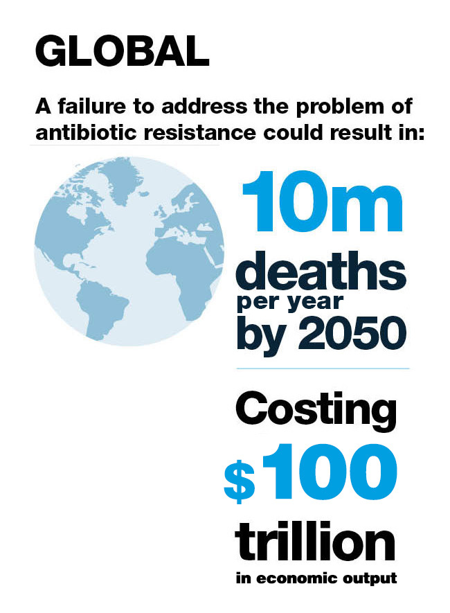
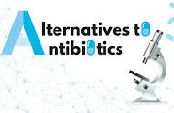
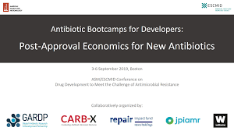


Future work

Slide 18
Questions???

